Slide 1


Slide 2

Session Objectives
In this workshop, we will discuss how rigor in applied epidemiological methods, combined with qualitative stakeholder involvement, can generate useful and realistic policy insights.

Slide 3
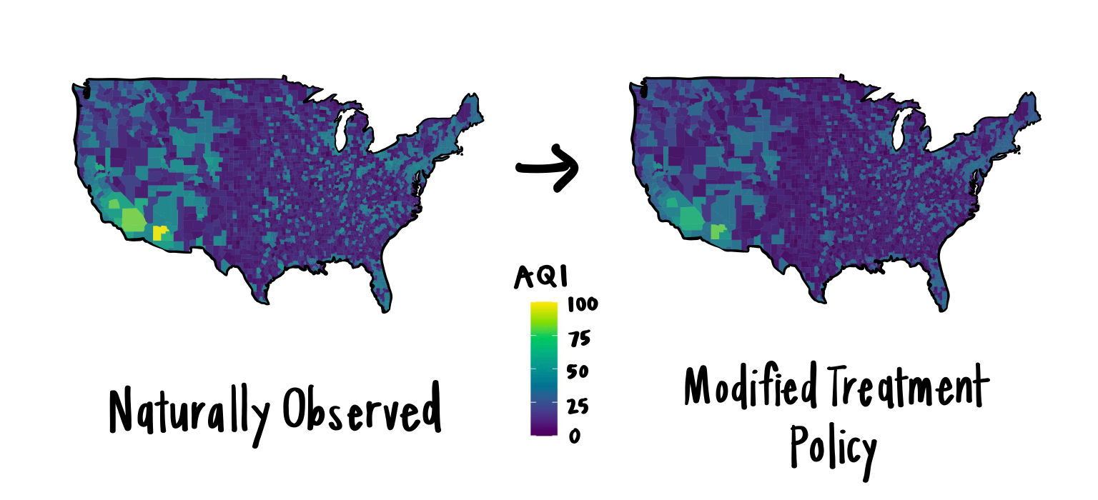
Modified Treatment Policies
Demonstrates how to operationalize policy emulation using Modified Treatment Policies (MTPs).
Using a dynamic shifts in continuous exposures, providing a methodologically rigorous alternative to static intervention causal frameworks.
Image source: https://www.khstats.com/blog/lmtp/lmtp.html

Slide 4

Causal Mediation Analysis
Will focus on identifying the mechanisms through which an exposure translates to an observed outcome.
Demonstrate utilizing causal mediation approaches, decompose total effects to understand structural pathways with oral health inequalities.

Slide 5
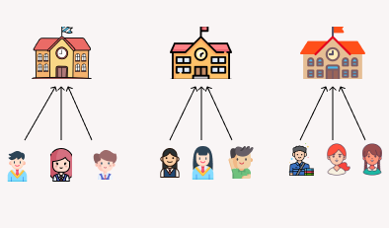
Contextual Effects
Will detail the methodological requirements for properly isolating contextual effects, demonstrating how higher-level ecological conditions systematically influence individual-level conditions and individual-level outcomes.

Slide 6
Stakeholder and Consumer Integration
Will bridge methodological simulation with applied policy formulation. By integrating consumer lived experiences and established stakeholder perspectives, we ensure that the resulting causal models directly map to actionable, culturally relevant policy priorities.

Slide 7


Slide 8
No conflict of interest

Slide 9

The Policymaker’s Dilemma
Imagine you are a policymaker with a $1M public health budget.
What kind of evidence would you demand before investing?
Associative Evidence “Sugar and dental decay go hand in hand.”
Causal Evidence “If we reduce sugar consumption by 20g per day, we avert 15% of all new dental disease.”
You need causal answers, not just correlations.

Slide 10
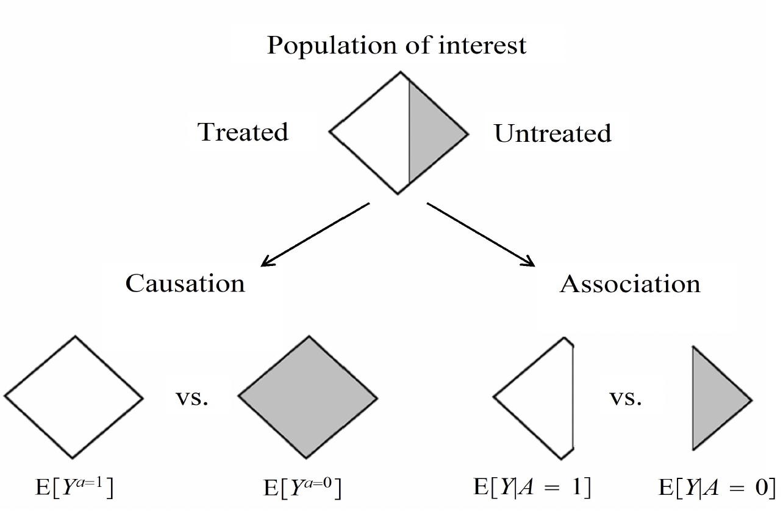
The Problem: Association ≠ Causation
🔍 Association (Comparing Subgroups)
The Approach: We partition the observed data.
The Contrast: We compare the dental outcomes of the “high sugar” fraction directly against the “low sugar” fraction.
The Focus: Contrasting different subsets of people.
🎯 Causation (Contrasting the Whole Population)
The Approach: We construct counterfactual scenarios.
The Contrast: We compare the entire population’s actual outcomes against the entire population’s expected outcomes under a new policy.
The Focus: Contrasting the exact same population under different conditions.
Figure source: Hernan MA, Robins JM (2020). Causal Inference: What If

Slide 11


What are causal assumptions
Exchangeability: To make valid causal claims, the groups we compare must be fundamentally similar across all relevant dimensions before the intervention. We require a true “apples to apples” comparison.
Positivity: A near certainty that some individuals will be assigned to each of the treatment groups.
Consistency: Requires two primary conditions to be met, well-defined interventions and the absence of multiple versions of treatment.
Figure source: Hernan MA, Robins JM (2020). Causal Inference: What If

Slide 12
MTP Demonstrations

Slide 13
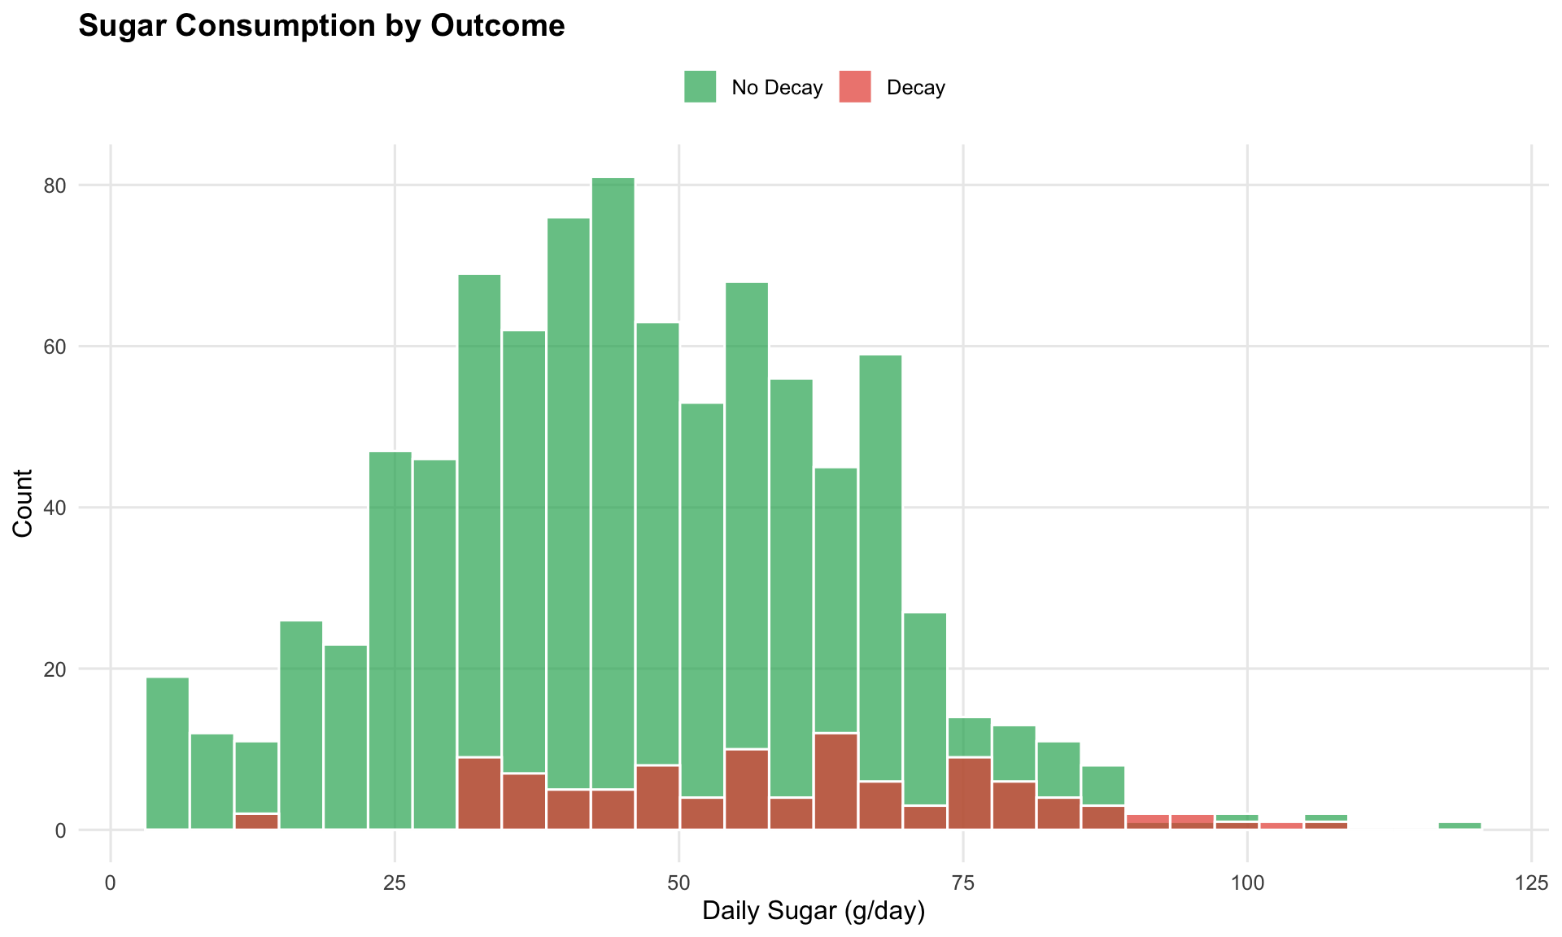
Our simulated dataset
1000 adults (cross-sectional):
Variable | Description
sugar_consumption | Daily sugar intake (g/day)
tooth_decay | Cavities present? (1=Yes, 0=No)
age | Age in years
sex | 0=Male, 1=Female
income | 1 (low) → 4 (high)
education | 1 (low) → 3 (high)
Overall decay prevalence: 10.4%
Causal Question: “If we reduce sugar consumption by 20g per day, what is the amount of new dental caries we avert in the population”

Slide 14
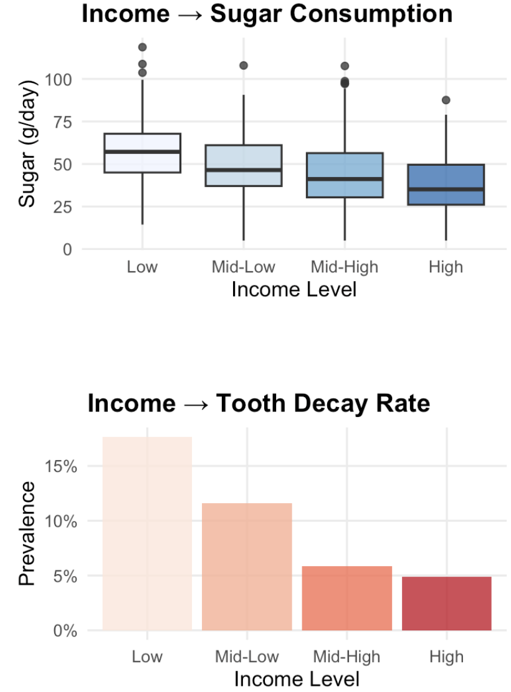
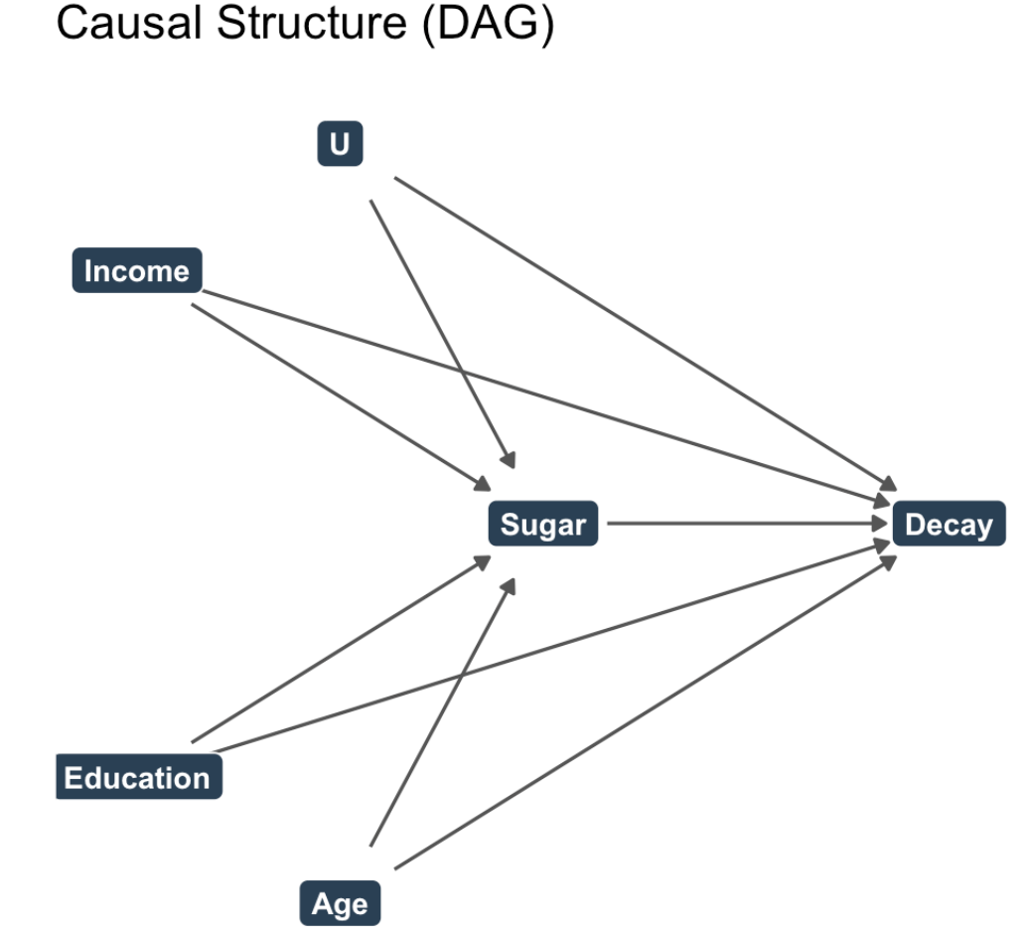
Structure of Confounding
Lower income people consume more sugar AND have more caries– reasons other than sugar alone

Slide 15
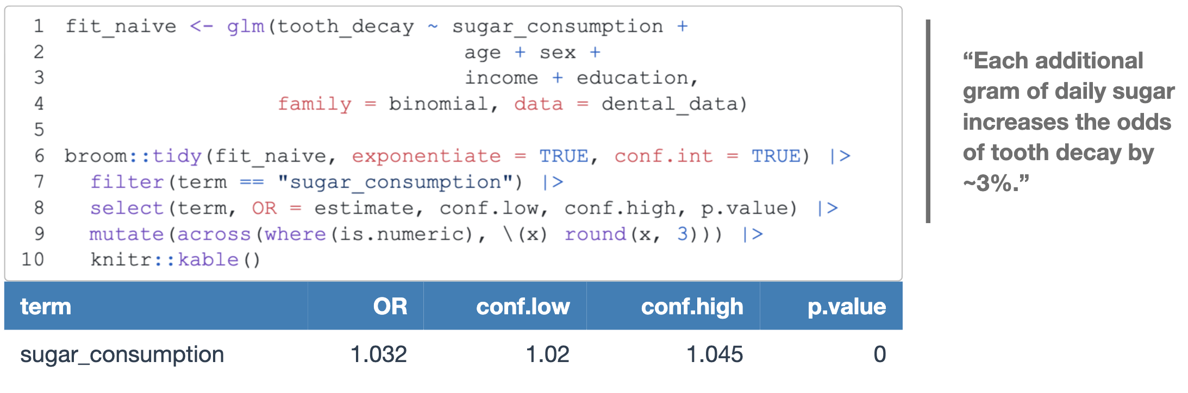
The Tempting Approach
Fit a logistic regression and read off the odds ratio:
But this answers: “Among people who happen to differ in sugar intake, how do outcomes compare?”
Not: “If we intervened to change sugar intake, what would happen?”

Slide 16
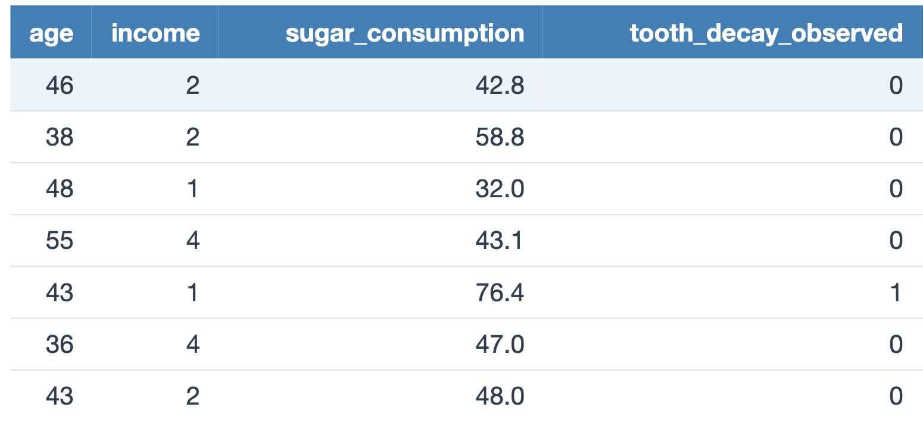
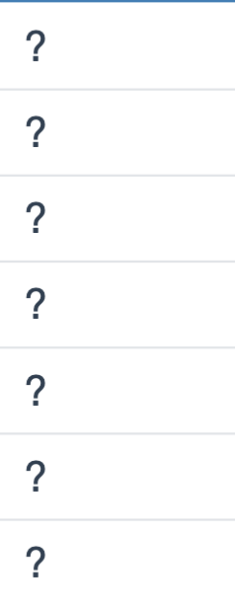
The Fundamental Problem of Causal Inference
“For each person, we only see ONE reality: what actually happened. We never see what would have happened if things were different.”
tooth_decay_if_sugar_reduces

Slide 17
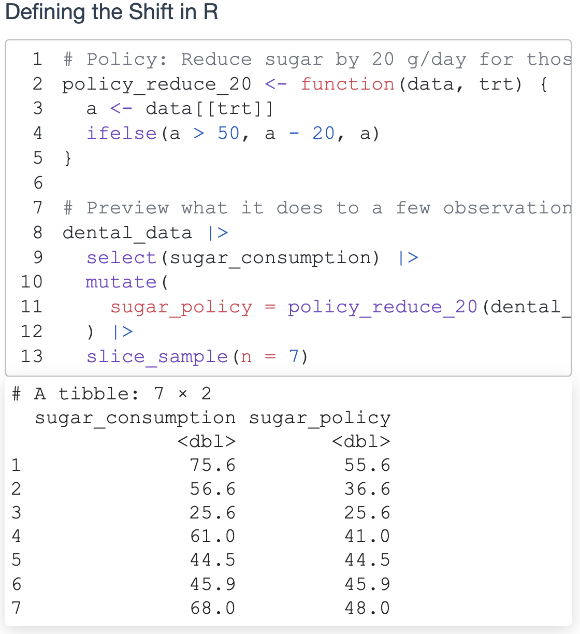
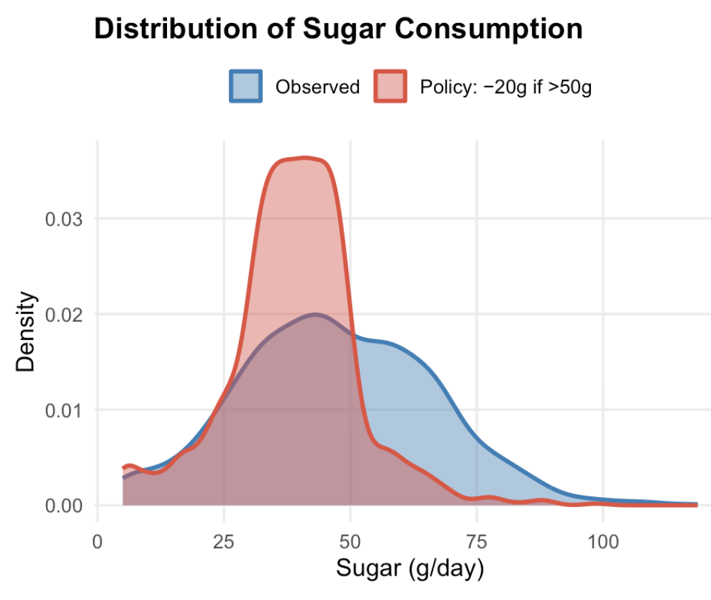
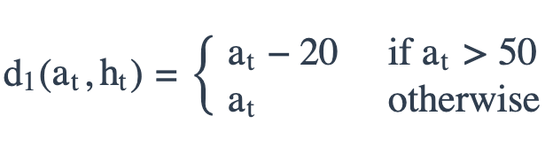
Static vs Modified Policy
Static (bad for continuous): > “Set everyone to exactly 40g sugar” — violates positivity
Modified Treatment Policy : > “For people eating more than 50g per day, reduce the consumption by 20g. For others, keep the same.”
- more plausible policy: we only ask heavy eaters to cut back, not everyone.

Slide 18
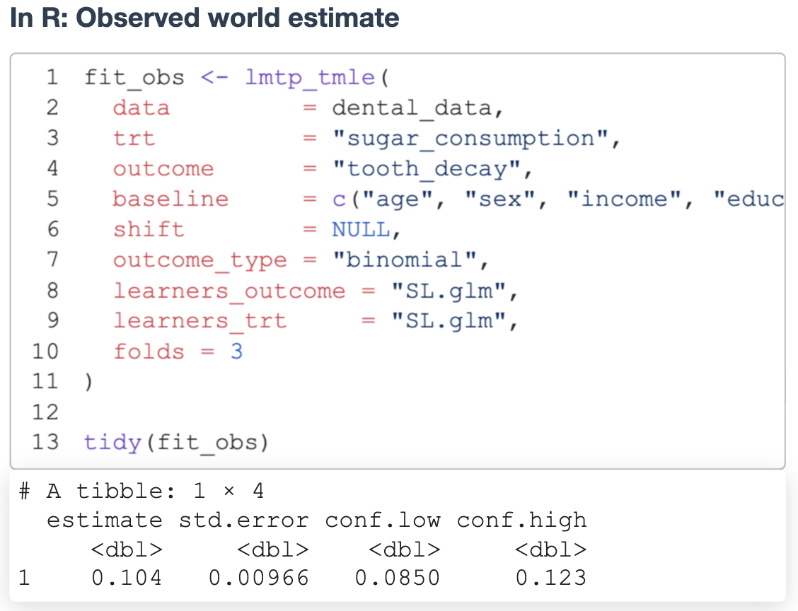
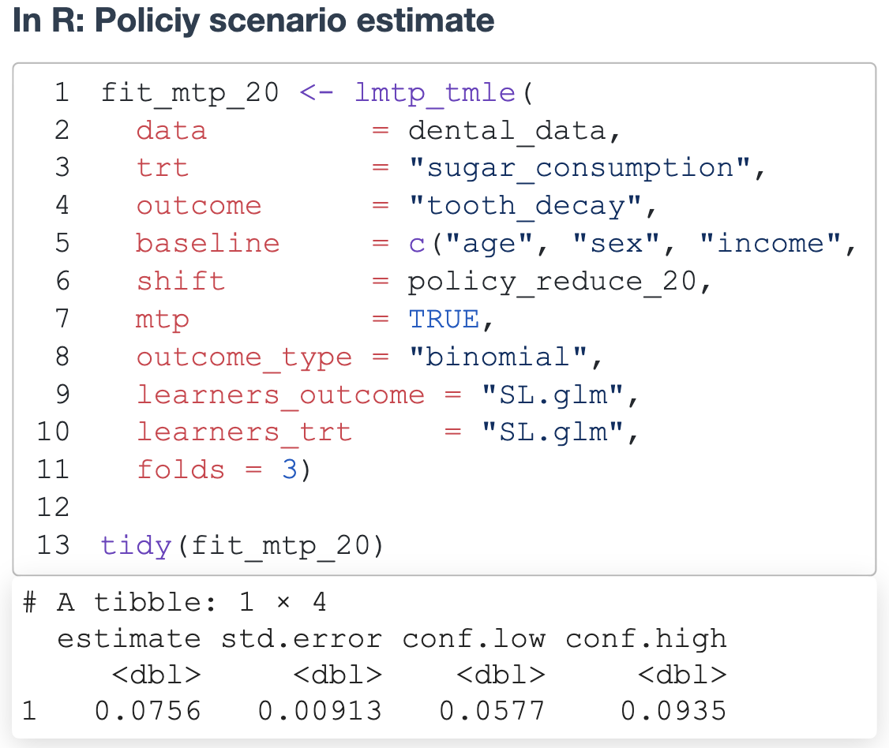
How does TMLE estimator work?
Split data → “Practice on half, test on half”
Model treatment → “Learn who eats how much sugar”
Model outcomes → “Predict cavities based on sugar + other factors”
Combine & correct → “if either the treatment model or the outcome model is imperfect, the estimate is still valid”

Slide 19
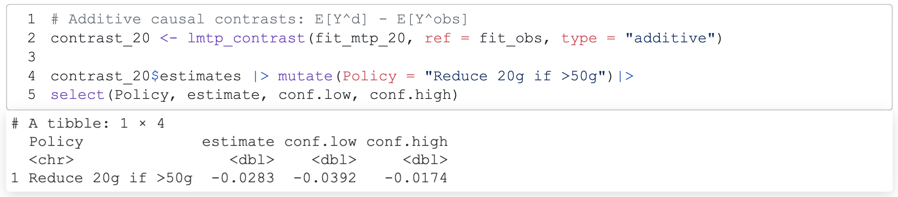
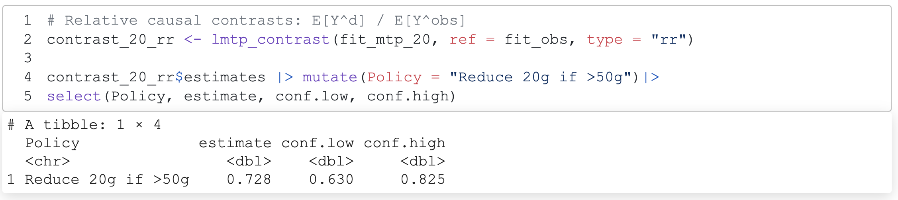
The Causal Contrasts

Slide 20
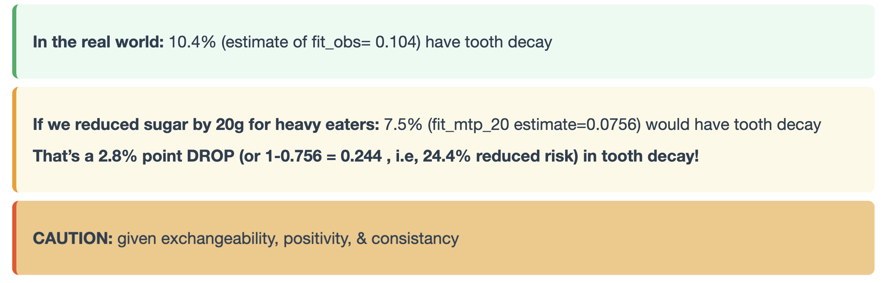
Interpreting the Answers

Slide 21
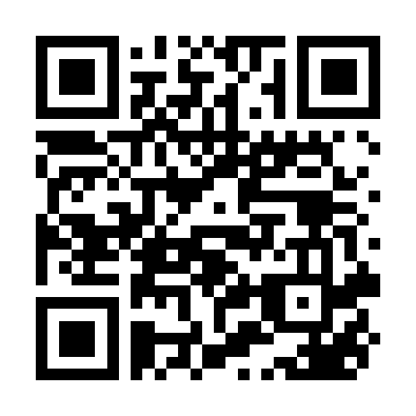
Summary
Regression shows “what goes with what”
MTP answers “what if we did this policy?”
Works even for continuous exposures like sugar
Gives to policy relevant questions
Ask causal questions. Define feasible interventions. Use the right tools.
Key papers
Díaz et al. (2023). Nonparametric Causal Effects Based on Longitudinal Modified Treatment Policies. JASA.
Kennedy (2019). Nonparametric Causal Effects Based on Incremental Propensity Score Interventions. JASA.
U Cooray et al. (2023) . Impact of poverty reduction on oral health outcomes among US adults. JDR
U Cooray et al. (2023) . Impact of teeth on social participation: modified treatment policy approach. JDR

